Slide 1
Drone Battery Life Optimizer
A Mini Project for Python Programming
Presented by: Kavya Priya A
Roll No: RA2211004020101

Slide 2
Introduction
Overview of drone battery limitations
Importance of maximizing flight time
Need for intelligent battery optimization in drones
Applications in agriculture, delivery, rescue, and surveillance
Aim: Develop a system to enhance drone battery efficiency

Slide 3
Features
Real-time battery monitoring
Adaptive power consumption algorithms
Smart route optimization for energy efficiency
Battery health prediction & alerts
Integration with drone control systems

Slide 4
Concepts Used
Lists & Dictionaries – Used to store transaction data and define category-wise spending limits
Functions – Organized code using add_entry() and show_summary() for better readability and reuse
Loops & Conditionals – Controlled the main menu and checked if spending exceeded category limits
String/Float Conversion – Handled user inputs accurately by converting values using float(input())
(Optional) File Handling – Enabled data saving in CSV format for persistence across sessions

Slide 5
Program Flow
Program starts by displaying a user-friendly menu
User selects an option: add income, add expense, view summary, or exit
Inputs are taken for amount and category during entry
Data is stored in memory (or optionally in a file for persistence)
Summary is generated by calculating totals and checking category limits

Slide 6
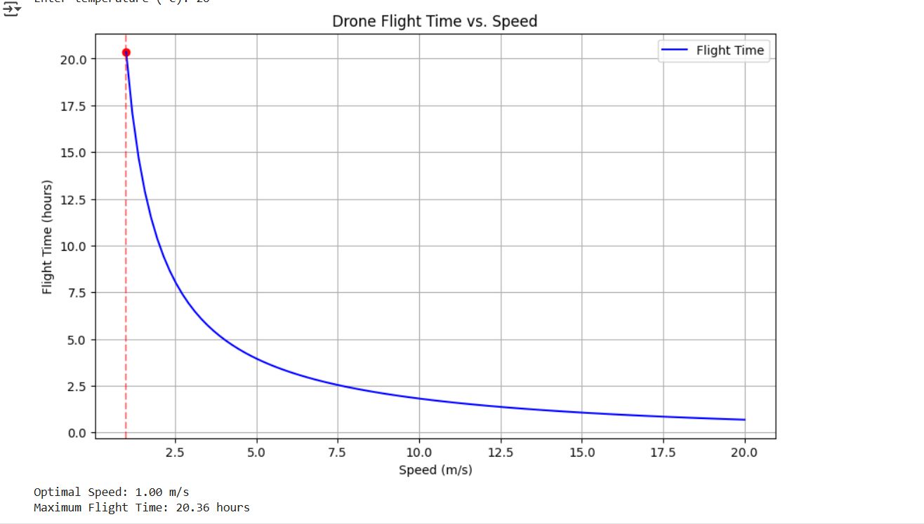
Sample Output

Slide 7
Conclusion
Optimizing battery life enhances drone utility
Smart systems reduce downtime and improve reliability
Applicable across multiple industries
Future scope: solar-assisted drones, swarm optimization
Conclusion: Smart battery optimization is essential for next-gen drones

